Slide 1

Tamil Nadu Engineering Admissions Predictor
SRM Institute of Science and Technology,
Ramapuram Campus, Chennai-89
DEPARTMENT OF COMPUTER SCIENCE AND ENGINEERING
Batch No: 3
DETAILS OF THE PROJECT MEMBERS:
1)A P AISHWARYA LAKSHMI (RA2011026020066)
2) S INDHUMATHI (RA2011026020088)
3) P RIDHANYA
(RA2011026020104)
SUPERVISOR DETAILS:
Mr. T. RAJESH
Dr. T.P. LATCHOUMI

Slide 2
OBJECTIVE
Objective :
The aim of the project is to predict the college that a student will be getting into with their PCM marks and caste.
Project Domain:
The domain of the project is Machine Learning. We have used Supervised Learning techniques to obtain the desired results.

Slide 3
SCOPE
The scope of a college admissions predictor, at a basic level, a predictor can provide a simple estimate of a student's chances of being admitted to a particular college or university based on their academic credentials and other factors.
Another aspect of the scope of a college admissions predictor is its level of transparency and accessibility. A good predictor should be transparent about the data and models used to make predictions, and should provide clear explanations of how the predictions are generated.
The predictor should also be accessible to all students, regardless of their background or resources, and should be designed in a way that is easy to use and understand.

Slide 4
ABSTRACT
Increasing student admission and enrollment, especially in engineering and computing programs, is a desirable goal for many universities. At the same time, this goal can be difficult to achieve. The aim of this project is to develop a data analytics model that can be used by universities and colleges to improve student admission and enrollment process.
Predictive analytics is the technique of using historical data to create, test, and validate a model to best describe and predict the probability of an outcome In Tamilnadu, we have the TNEA process.
We also have centralized IIT exams for all students from India. To make any process easier, visualization and proper understanding of data is needed, or the ability to predict. There has also been an increasing demand for courses like Computer Science, especially Big Data, IoT, Artificial Intelligence, Cloud computing, and such.

Slide 5
INTRODUCTION
The purpose of this project is to predict college admissions in Tamil Nadu. Applying to college can feel uncertain and even mysterious. Students and supporters are inundated with information through marketing and media, and it quickly becomes an overwhelming experience.
A college admissions predictor is a tool that uses statistical models and data analysis to predict a student's chances of being admitted to a particular college or university. It takes into account various factors that are typically considered by admissions officers, such as a student's academic performance, test scores, extracurricular activities,etc.
Using a college admissions predictor can help students and their families make more informed decisions about which colleges to apply to, and how to allocate their time and resources in the application process.

Slide 6
INTRODUCTION
By inputting their credentials and background information, students can estimate their chance of being admitted to a particular college, and can use this information to prioritize their applications and set realistic expectations.
It is important to note, however, that college admissions predictors are not perfect, and should be used as just one tool in the college search and application process. Admissions decisions are often influenced by subjective factors that cannot be easily quantified, and each college has its own unique admissions process and criteria.
Nevertheless, a college admissions predictor can be a useful starting point for students as they navigate the complex and competitive world of college admissions.

Slide 7
SYSTEM REQUIREMENTS
Hardware Requirements
Software Requirements

Slide 8
Literature Review – Survey Table
Title :
Authors:
Year :
Inference:
Advantages:
Disadvantages:

Slide 9
Literature Review – Survey Table
Title :
Authors:
Year :
Inference:
Advantages:
Disadvantages:

Slide 10
Existing System

Slide 11
Proposed System

Slide 12
Architecture Diagram

Slide 13
MODULE DESCRIPTION
1.Data pre-processing: This module would prepare the data for analysis, including cleaning the data, imputing missing values, and scaling or transforming the data as necessary.
2.
Model training: This module would train the regression model on the input and output variables using a chosen algorithm. The algorithm could be linear regression, multiple linear regression, or another type of regression algorithm.
Prediction: This module would use the trained model to predict the values of the output variables for new input data. It could also provide uncertainty estimates or confidence intervals for the predictions.
Visualization: This module would provide visualizations of the data and the model output to aid in understanding and interpretation. It could include scatter plots, line plots, heat maps, and other types of visualizations.
3. Creating the user interface: This module would create a user interface using the Streamlit library that allows users to input their data and receive a predicted outcome for their college admissions chances. The user interface can include fields for entering PCM marks and castes.
Deploying app: This module would deploy the app using Streamlit to make it accessible over the internet.

Slide 14
Algorithm Used in each module
Data collection
Data pre-processing: Nominal encoding(Integer representation/One hot encoding)
Building and Training the model: RandomForestClassifier
Making predictions: MultiOutputClassifier

Slide 15
Module 1 :
Data collection:
TNEA (Tamil Nadu Engineering Admissions) is a website managed by the Directorate of Technical Education, Tamil Nadu, India. The website provides information on the admission process for undergraduate engineering programs in the state of Tamil Nadu.
Admission data: The website collects data on the admission process, including the cutoff marks for various engineering courses, the counseling schedule, and the seat allotment process.
The TNEA website provides a wealth of information on the admission process for engineering programs in Tamil Nadu, including data on colleges, courses, and the admission process itself. This data can be used by students, parents, and education professionals to make informed decisions about college admissions in Tamil Nadu.
https://cutoff.tneaonline.org/
Data pre-processing:
Filling missing values with the median of all values.

Slide 16
Module 2
Filling missing values with median values is a technique used in data preprocessing to handle missing data in a dataset. When a dataset contains missing values, it can cause problems for machine learning models, which may not be able to handle missing data. Filling in missing values with median values is a common technique used to address this problem. Here's how it works:
Identify missing values: First, identify the missing values in the dataset. This can be done using a variety of techniques, such as using the Pandas library in Python to search for null values.
Calculate the median: Next, calculate the median value for each column in the dataset. The median is the middle value in a dataset when the values are sorted in ascending order. If the dataset contains an even number of values, the median is the average of the two middle values.
Fill missing values: Finally, replace the missing values in each column with the median value for that column. This is done using the Pandas library in Python, which provides a method called "fillna" that can be used to fill in missing values with a specified value.
Filling missing values with median values is a simple and effective way to handle missing data in a dataset. It can help to improve the accuracy of machine learning models by ensuring that all data is complete and consistent. However, it's important to note that this technique is not always the best choice, and other methods, such as using regression models or imputation techniques, may be more appropriate depending on the nature of the data and the goals of the analysis.

Slide 17
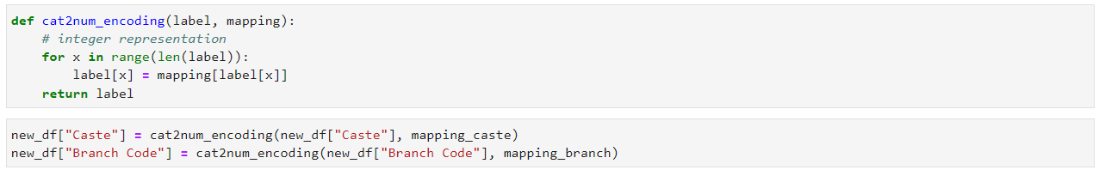
Module 1 :
Multioutput Regression Model :
ALGORITHM USED: RandomForestRegressor
Categorical Encoding is a process where we transform categorical data into numerical data.
Nominal Encoding: When we have a feature where variables are just names and there is no order or rank to this variable's feature.

Slide 18
Module 1
Nominal encoding is a technique used in data preprocessing to convert categorical variables into a numerical format that can be used in machine learning algorithms. Categorical variables are variables that represent discrete values or categories, such as colors, names, or labels.
Nominal encoding involves assigning a unique numerical value to each category in the categorical variable. This is typically done using an integer encoding, where each category is assigned a different integer value. For example, if a dataset has a categorical variable "color" with three categories (red, green, and blue), each category might be assigned a unique integer value (red = 1, green = 2, blue = 3).
There are several ways to perform nominal encoding, including:
One-Hot Encoding: This method involves creating a binary feature for each category in the categorical variable. Each feature is assigned a value of 0 or 1, depending on whether the observation belongs to that category or not. For example, if a dataset has a categorical variable "color" with three categories (red, green, and blue), one-hot encoding would create three binary features (color_red, color_green, color_blue), with values of 0 or 1.

Slide 19
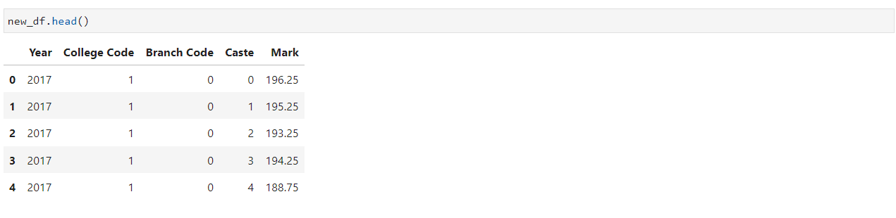
Module 1
NOMINAL ENCODING:

Slide 20
Module 2
BUILDING AND TRAINING THE MODEL
Multi target classification.
This strategy consists of fitting one classifier per target. This is a simple strategy for extending classifiers that do not natively support multi-target classification.

Slide 21
Module 2
Multi-output classification is a type of machine learning that predicts multiple outputs simultaneously. In multi-output classification, the model will give two or more outputs after making any prediction. In other types of classifications, the model usually predicts only a single output.
An example of a multi-output classification model is a model that predicts the type and color of fruit simultaneously. The type of fruit can be, orange, mango and pineapple. The color can be, red, green, yellow, and orange. The multi-output classification solves this problem and gives two prediction results.

Slide 22
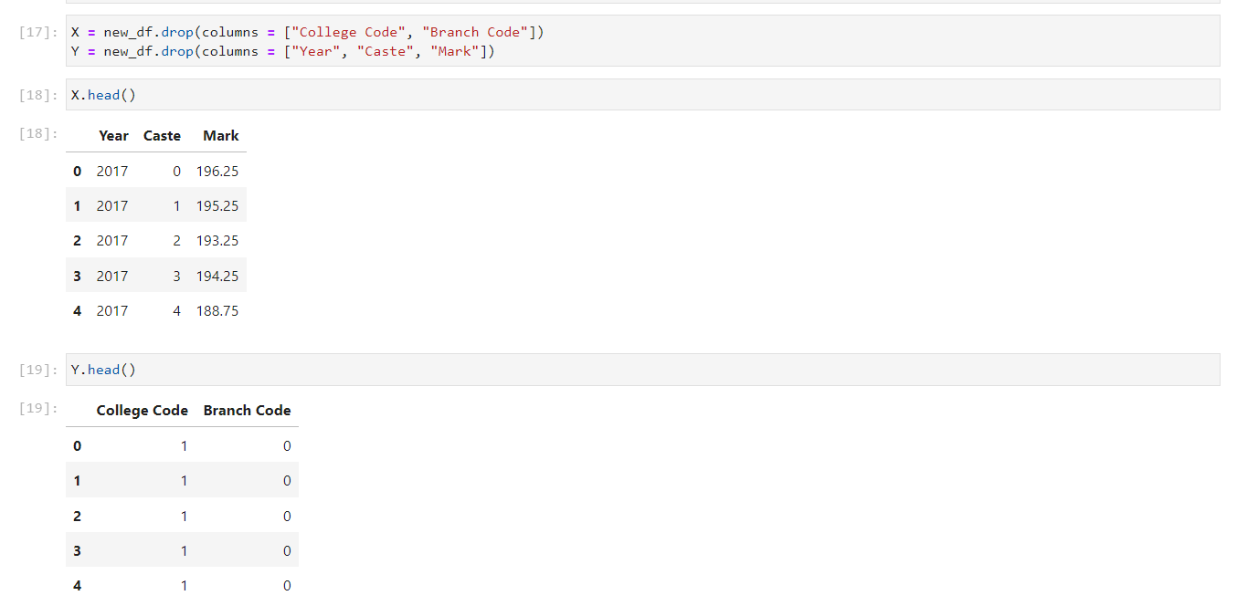
Module 2
TRAINING THE MODEL

Slide 23
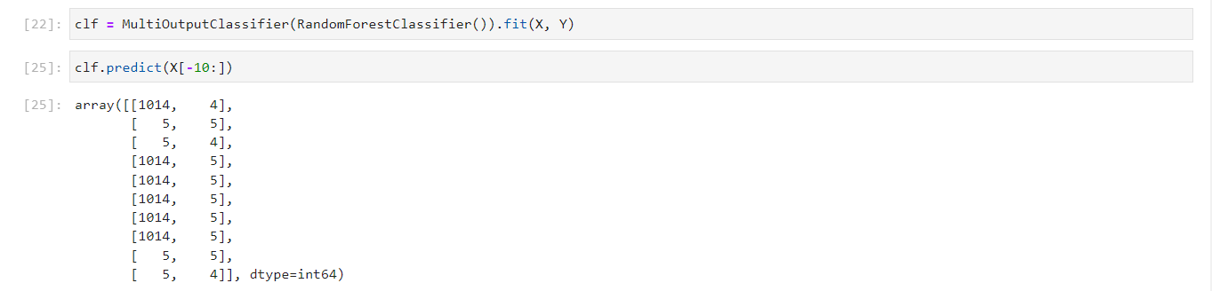
Module 2
MAKING PREDICTIONS: From the output above, the model has produced two prediction outputs. Therefore, we have successfully built our multi-output text classification model.

Slide 24
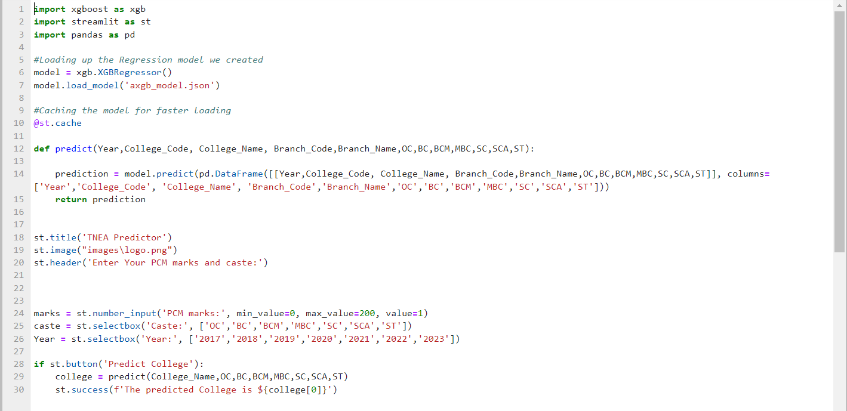
Module 3
Creating the User Interface

Slide 25
Module 3
Deploying the app:
Deploying a model using Streamlit refers to the process of creating a web application that allows users to interact with a trained machine learning model through a graphical user interface. Streamlit is a Python library that simplifies the process of building web applications and visualizations for machine learning models.
Once the app is deployed, users can access it through a web browser and interact with the machine learning model by entering input data and viewing the model's predictions or other results. The Streamlit app provides a user-friendly and accessible way to share machine learning models with a wider audience and enable them to benefit from the insights provided by the model.

Slide 26
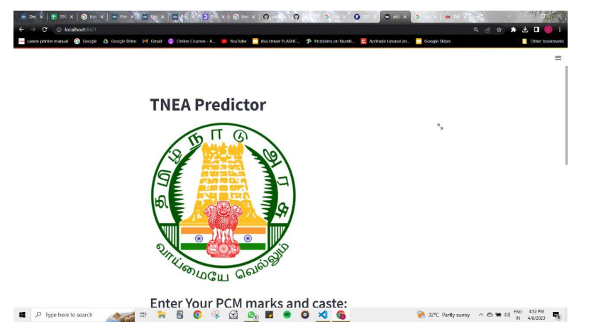
Module 3

Slide 27
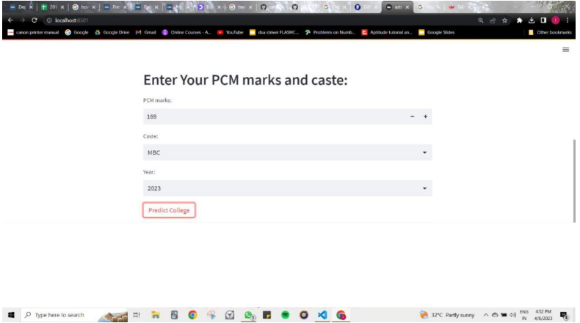
Module 3

Slide 28
REFERENCES
https://scikit-learn.org/stable/modules/generated/sklearn.multioutput.MultiOutputClassifier.html
https://medium.com/nerd-for-tech/nominal-and-ordinal-encoding-in-data-science-c93872601f16#:~:text=types%20of%20encoding%2C-,Nominal%20Encoding,order%20or%20rank%2C%20or%20sequence.

